Slide 1
Lecture 3: Outline
Matter
Classifying Matter
States of Matter
Class Exercises

Slide 2
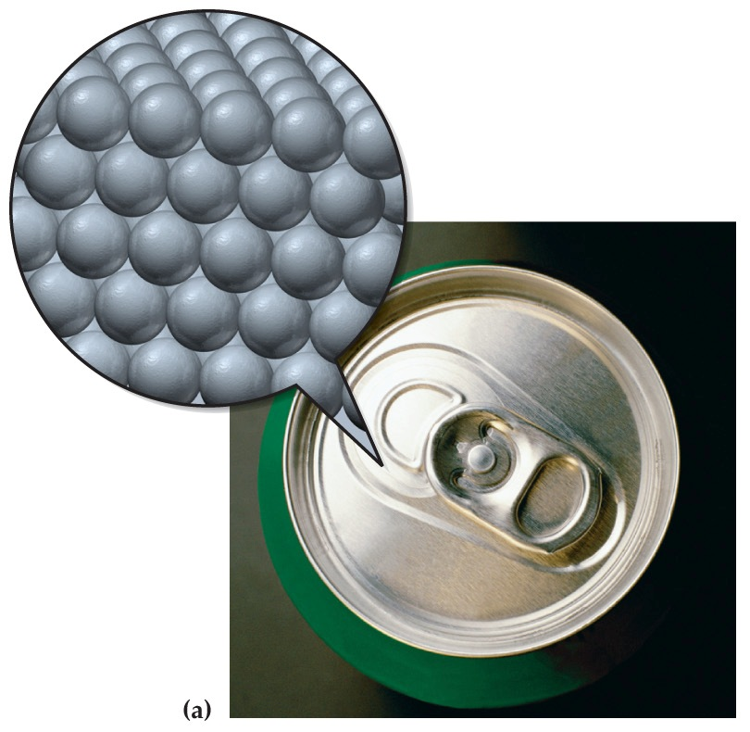
What Is Matter?
Matter -anything that occupies space and has mass.
Composed of a lot of tiny little pieces we call atoms and molecules/compounds.

Slide 3
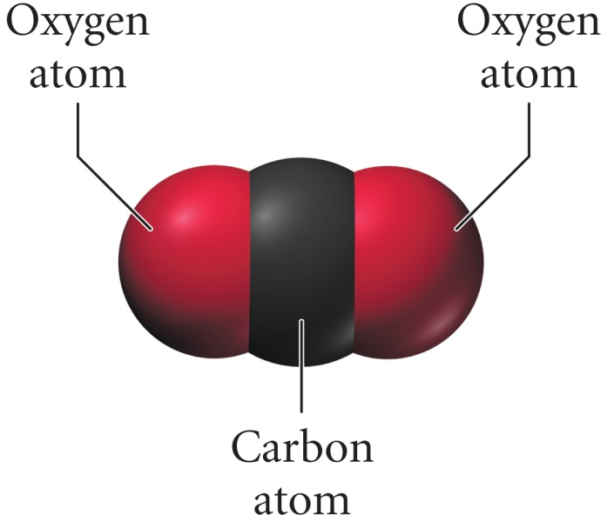
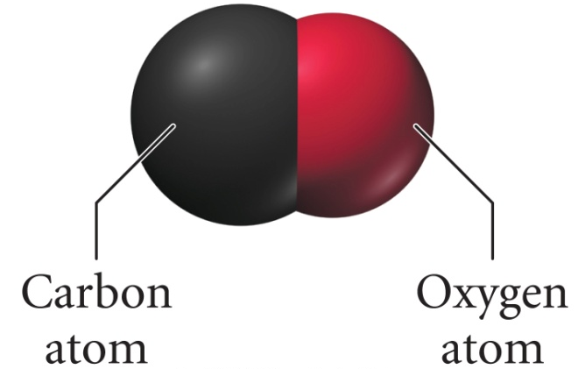
Structure Determines Properties
The properties of matter are determined by the atoms and molecules that compose it.
Carbon Monoxide
Carbon Dioxide
Composed of one carbon atom and one oxygen atom.
Colorless, odorless gas.
Burns with a blue flame.
Binds to hemoglobin.
Composed of one carbon atom and two oxygen atoms.
Colorless, odorless gas.
Incombustible.
Does not bind to hemoglobin.

Slide 4
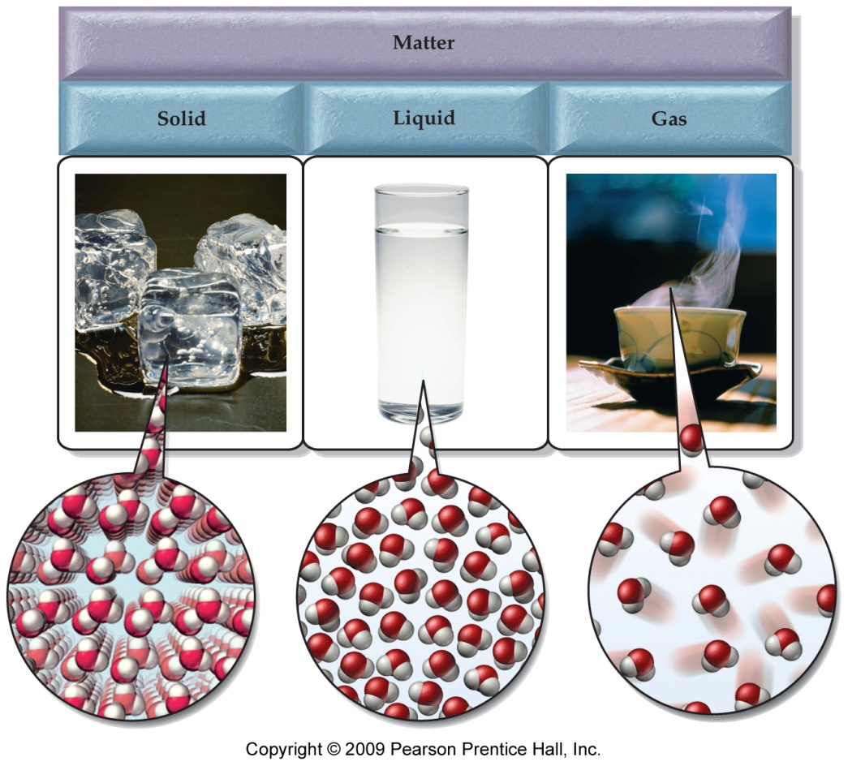
States of Matter
Solid, Liquid, Gas

Slide 5
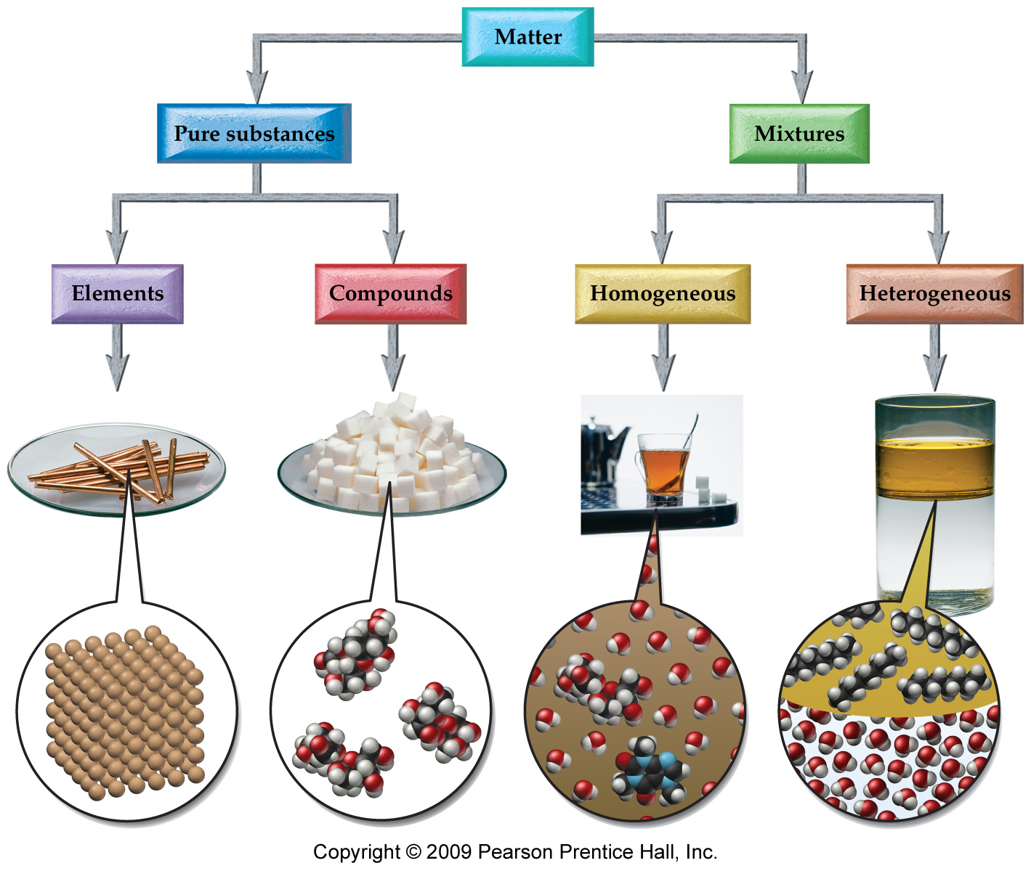
Classifying Matter

Slide 6
Classifying Matter

Slide 7
Classifying Matter

Slide 8
Classifying Matter

Slide 9
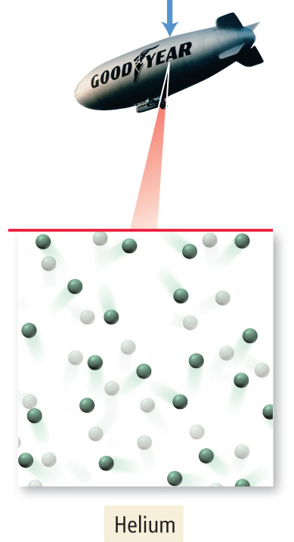
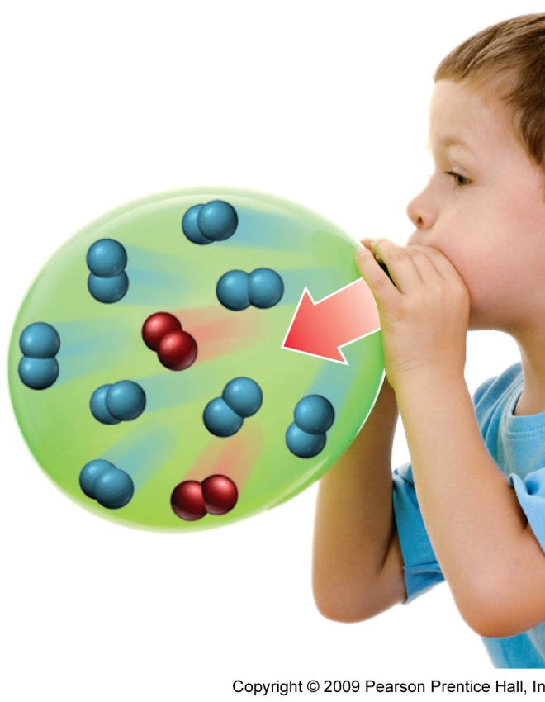
Classifying Matter
Atomic Element
Molecular Element
He
O₂ & N₂

Slide 10
Stuff to Memorize Diatomic Elements
H₂, N₂, O₂, F₂, Cl₂, Br₂, I₂
Horses Need Oats For Clear Brown I’s
Form diatomic molecules when they are by themselves.

Slide 11
Checkpoints
Oxygen, Oxide, etc.
Chlorine, , -ide, ite, etc

Slide 12
States of Matter
Solid, Liquid, Gas

Slide 13
Lecture 3: Outline
Matter
Classifying Matter
States of Matter
Nomenclature & Writing Chemical Formulas

Slide 14
Memorization

Slide 15
Group Activity #1
Write formulas and names for one example of each of the following
Monatomic Anion
Monatomic Cation
Polyatomic Anion
Polyatomic Cation
Ionic Compound (with Type I Metal)
Ionic Compound (with Type II Metal)
Ionic Compound with polyatomic ion (if not above)
Acid
Binary Molecular Compound
Diatomic element

Slide 16
Group Activity #2
Look at old Exam

Slide 17
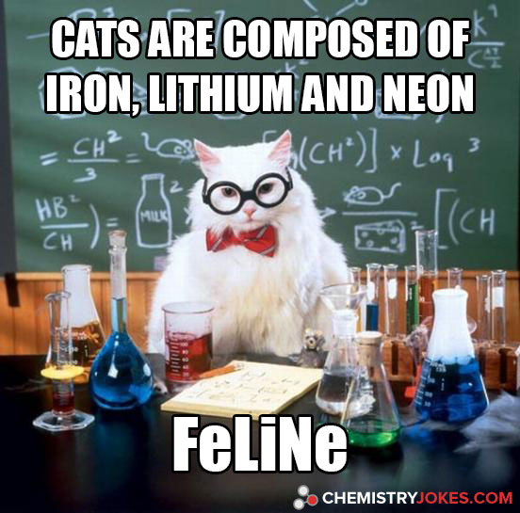
Cat joke

